Slide 1
Project-
Housing Price Prediction
Mallesh R

Slide 2
Business Problem:
Houses are one of the necessary need of each and every person around the globe and therefore housing and real estate market is one of the markets which is one of the major contributors in the world’s economy. It is a very large market and there are various companies working in the domain. Data science comes as a very important tool to solve problems in the domain to help the companies increase their overall revenue, profits, improving their marketing strategies and focusing on changing trends in house sales and purchases. Predictive modelling, Market mix modelling, recommendation systems are some of the machine learning techniques used for achieving the business goals for housing companies. Our problem is related to one such housing company.
A US-based housing company named Surprise Housing has decided to enter the Australian market. The company uses data analytics to purchase houses at a price below their actual values and flip them at a higher price.

Slide 3
Business Goal:
You are required to model the price of houses with the available independent variables. This model will then be used by the management to understand how exactly the prices vary with the variables. They can accordingly manipulate the strategy of the firm and concentrate on areas that will yield high returns. Further, the model will be a good way for the management to understand the pricing dynamics of a new market.

Slide 4
Analytical Problem Framing
Mathematical/ Analytical Modeling of the Problem:
This model is a supervised model where the target variable is continuous datatype. Thus we will be using all the best Regression models to find the price of the house. We will determine the best regression model based on the score value and the root mean square error.

Slide 5
Data Sources and their formats:
The dataset has all the information about the house collected by the company which are real world data with lots of observations. The description of each variable are in the below link.Click here.
Data Preprocessing Done:
Data Preprocessing is done by starting to clean the missing values in the dataset. There are lots of missing data in each features some of them are replaced with the respective datatype and others where filled based on the data description. Then the skewness of the numerical dataset is reduced by some power transformation technique and the categorical dataset has been encoded for building the model.

Slide 6
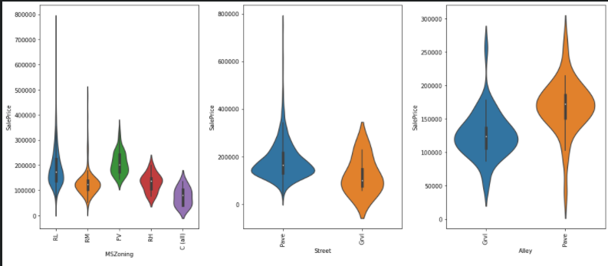
Data Visualisation

Slide 7
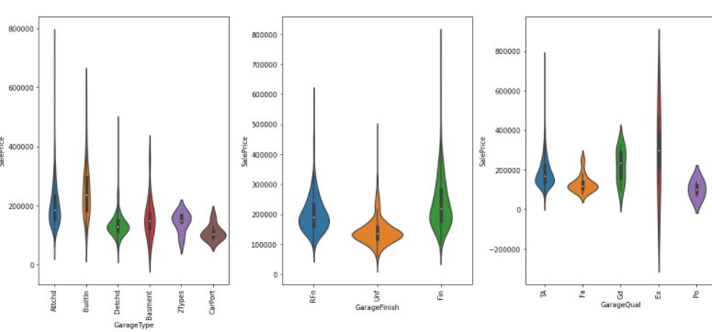
Data Visualisation
The visualisation is done for each features to understand the pattern and the relationship between features and traget variable

Slide 8
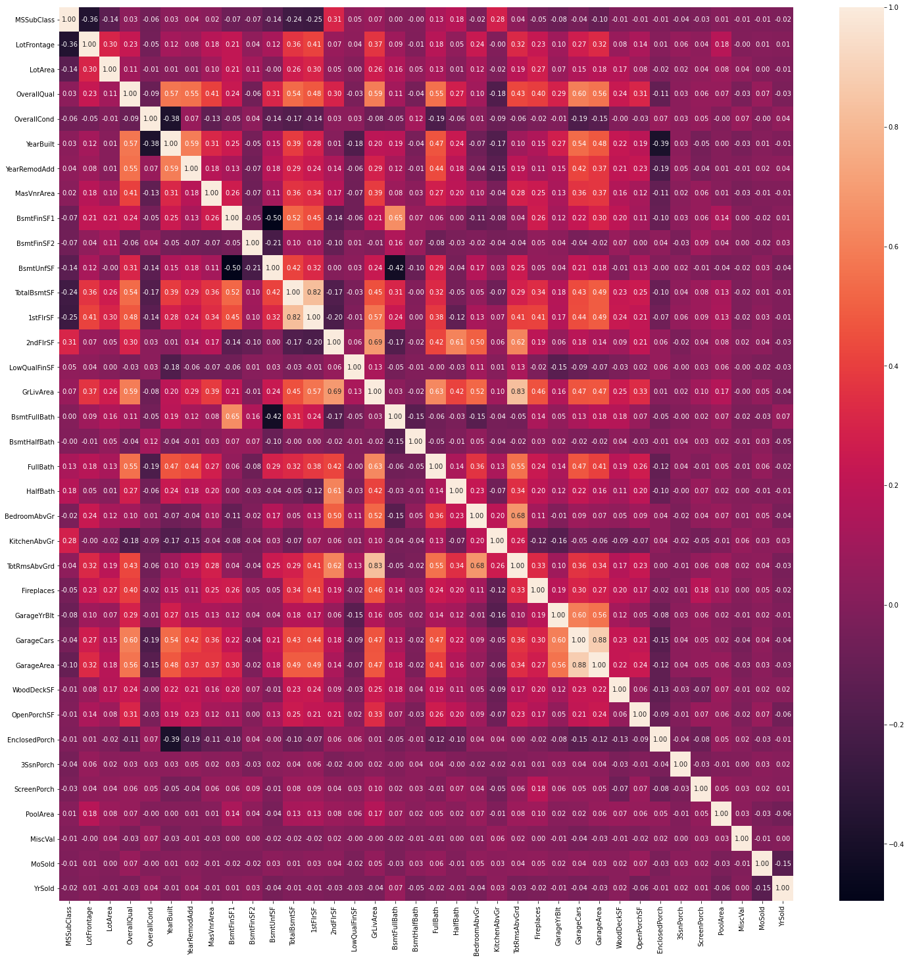
Correlation Matrix

Slide 9
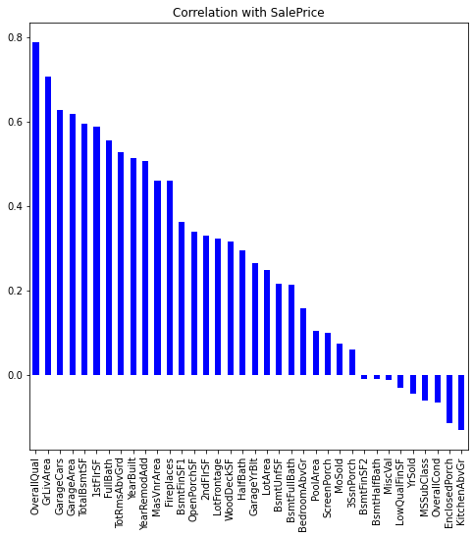
Correlation with Target variable

Slide 10
Model Building
The Model building and their performance are evaluated using Root mean square error. Each model is trained with the traing data and the predictions are made based on the model pattern. We have build around 8 models from that we will choose the best performance model.
Model | R2 score | Cross val | MAE | MSE | RMSE
SVR | 0.906487 | 0.874458 | 0.089500 | 0.015468 | 0.124372
Lasso | 0.905874 | 0.856103 | 0.090215 | 0.015570 | 0.124779
GradientBoostingRegressor | 0.899122 | 0.878088 | 0.088481 | 0.016687 | 0.129177
Ridge | 0.898425 | 0.837506 | 0.091938 | 0.016802 | 0.129623
LGBMRegressor | 0.888268 | 0.867177 | 0.096749 | 0.018482 | 0.135949
XGBRegressor | 0.882803 | 0.849815 | 0.096581 | 0.019386 | 0.139234
RandomForestRegressor | 0.870128 | 0.855958 | 0.099397 | 0.021483 | 0.146570

Slide 11
THANK YOU

